Slide 1
UNIT-III (Part-1)
Software Process Models

Slide 2
Software process model
Process models prescribe a distinct set of activities, actions, tasks, milestones, and work products required to engineer high quality software.
Process models are not perfect, but provide roadmap for software engineering work.
Software models provide stability, control, and organization to a process that if not managed can easily get out of control.
Software process models are adapted to meet the needs of software engineers and managers for a specific project.

Slide 3
Why Models are needed?
Symptoms of inadequacy: the software crisis
scheduled time and cost exceeded
user expectations not met
poor quality

Slide 4
Prescriptive Model
Prescriptive process models advocate an orderly approach to software engineering
Organize framework activities in a certain order
Process framework activity with set of software engineering actions.
Each action in terms of a task set that identifies the work to be accomplished to meet the goals.
The resultant process model should be adapted to accommodate the nature of the specific project, people doing the work, and the work environment.
Software engineer choose process framework that includes activities like;
Communication
Planning
Modeling
Construction
Deployment

Slide 5
Prescriptive Model
Calling this model as “Prescribe” because it recommend a set of process elements, activities, action task, work product & quality.
Each elements are inter related to one another (called workflow).

Slide 6
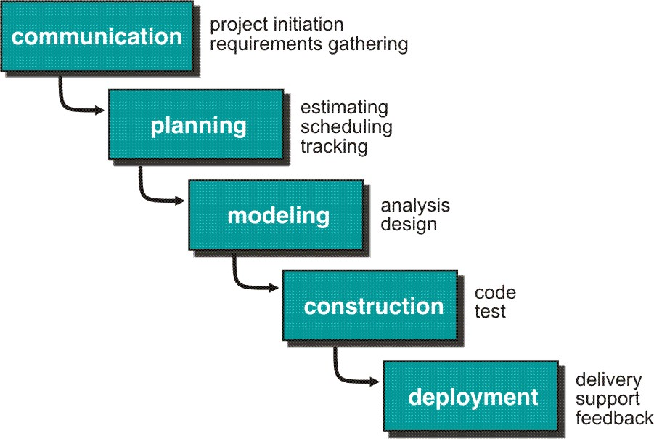
Waterfall Model or Classic Life Cycle

Slide 7
Waterfall Model or Classic Life Cycle
Requirement Analysis and Definition: What - The systems services, constraints and goals are defined by customers with system users.
Scheduling tracking -
Assessing progress against the project plan.
Require action to maintain schedule.
System and Software Design: How –It establishes and overall system architecture. Software design involves fundamental system abstractions and their relationships.
Integration and system testing: The individual program unit or programs are integrated and tested as a complete system to ensure that the software requirements have been met. After testing, the software system is delivered to the customer.
Operation and Maintenance: Normally this is the longest phase of the software life cycle. The system is installed and put into practical use. Maintenance involves correcting errors which were not discovered in earlier stages of the life-cycle.

Slide 8
Limitations of the waterfall model
The nature of the requirements will not change very much During development; during evolution
The model implies that you should attempt to complete a given stage before moving on to the next stage
Does not account for the fact that requirements constantly change.
It also means that customers can not use anything until the entire system is complete.
The model implies that once the product is finished, everything else is maintenance.
Surprises at the end are very expensive
Some teams sit ideal for other teams to finish
Therefore, this model is only appropriate when the requirements are well-understood and changes will be fairly limited during the design process.

Slide 9
Problems:
Real projects are rarely follow the sequential model.
Difficult for the customer to state all the requirement explicitly.
Assumes patience from customer - working version of program will not available until programs not getting change fully.

Slide 10
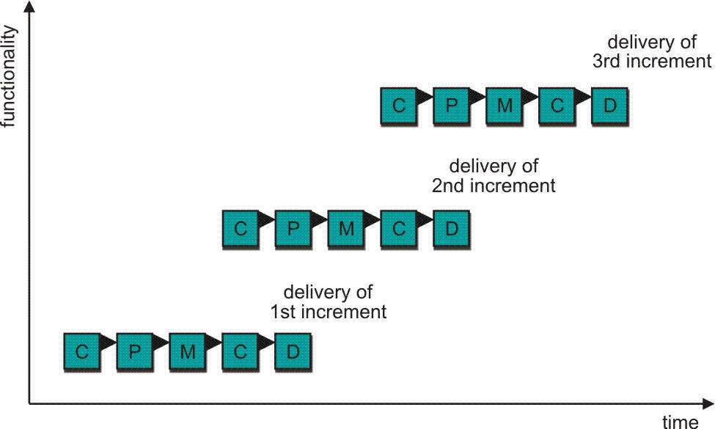
Incremental Process Model
C- Communication
P - Planning
M – Modeling
C - Construction
D - Deployment
Delivers software in small but usable pieces, each piece builds on pieces already delivered

Slide 11
The Incremental Model
Rather than deliver the system as a single delivery, the development and delivery is broken down into increments with each increment delivering part of the required functionality.
First Increment is often core product.
Includes basic requirement
Many supplementary features (known & unknown) remain undelivered
A plan of next increment is prepared
Modifications of the first increment
Additional features of the first increment
It is particularly useful when enough staffing is not available for the whole project
Increment can be planned to manage technical risks.
Incremental model focus more on delivery of operation product with each increment.

Slide 12
The Incremental Model
User requirements are prioritised and the highest priority requirements are included in early increments.
Once the development of an increment is started, the requirements are frozen though requirements for later increments can continue to evolve.
Customer value can be delivered with each increment so system functionality is available earlier.
Early increments act as a prototype to help elicit requirements for later increments.
Lower risk of overall project failure.
The highest priority system services tend to receive the most testing.

Slide 13
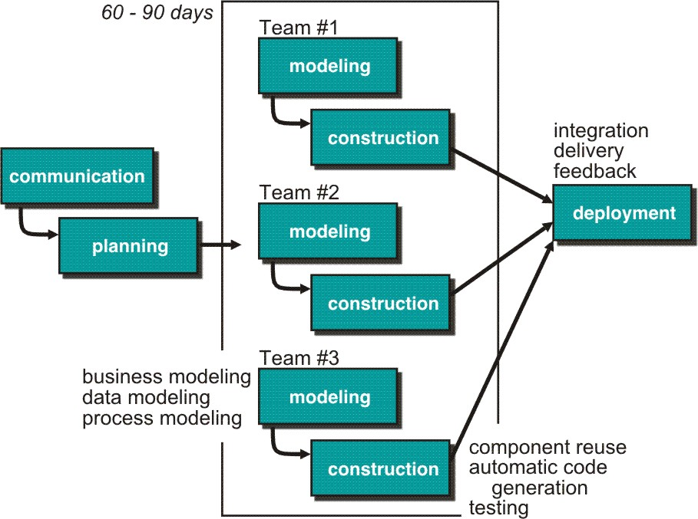
Rapid Application Development (RAD) Model
Makes heavy use of reusable software components with an extremely short development cycle

Slide 14
RAD Model
Communication – to understand business problem.
Planning – multiple s/w teams works in parallel on diff. system.
Modeling –
Business modeling – Information flow among business is working.
Ex. What kind of information drives?
Who is going to generate information?
From where information comes and goes?
Data modeling – Information refine into set of data objects that are needed to support business.
Process modeling – Data object transforms to information flow necessary to implement business.

Slide 15
Construction – it highlighting the use of pre-existing software component.
Deployment – Deliver to customer basis for subsequent iteration.
RAD model emphasize a short development cycle.
“High speed” edition of linear sequential model.
If requirement are well understood and project scope is constrained then it enable development team to create “ fully functional system” within a very short time period.

Slide 16
RAD Model
If application is modularized (“Scalable Scope”), each major function to be completed in less than three months.
Each major function can be addressed by a separate team and then integrated to form a whole.
Drawback:
For large but scalable projects
RAD requires sufficient human resources
Projects fail if developers and customers are not committed in a much shortened time-frame
Problematic if system can not be modularized
Not appropriate when technical risks are high ( heavy use of new technology)

Slide 17
Evolutionary Process Model
Produce an increasingly more complete version of the software with each iteration.
Evolutionary Models are iterative.
Evolutionary models are:
Prototyping
Spiral Model
Concurrent Development Model
Fourth Generation Techniques (4GT)

Slide 18
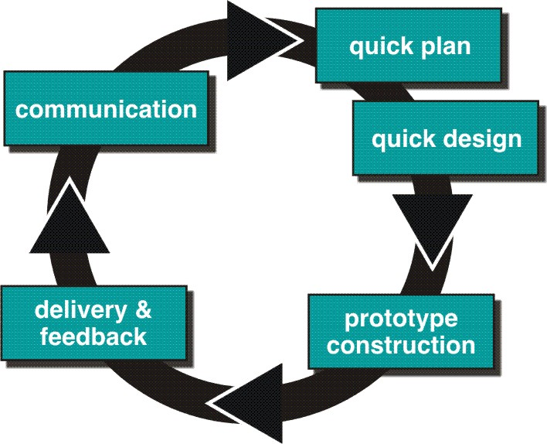
Evolutionary Process Models : Prototyping

Slide 19
Prototyping cohesive
Best approach when:
Objectives defines by customer are general but does not have details like input, processing, or output requirement.
Developer may be unsure of the efficiency of an algorithm, O.S., or the form that human machine interaction should take.
It can be used as standalone process model.
Model assist software engineer and customer to better understand what is to be built when requirement are fuzzy.
Prototyping start with communication, between a customer and software engineer to define overall objective, identify requirements and make a boundary.
Going ahead, planned quickly and modeling (software layout visible to the customers/end-user) occurs.
Quick design leads to prototype construction.
Prototype is deployed and evaluated by the customer/user.
Feedback from customer/end user will refine requirement and that is how iteration occurs during prototype to satisfy the needs of the customer.

Slide 20
Prototyping (cont..)
Prototype can be serve as “the first system”.
Both customers and developers like the prototyping paradigm.
Customer/End user gets a feel for the actual system
Developer get to build something immediately.
Problem Areas:
Customer cries foul and demand that “a few fixes” be applied to make the prototype a working product, due to that software quality suffers as a result.
Developer often makes implementation in order to get a prototype working quickly without considering other factors in mind like OS, Programming language, etc.
Customer and developer both must be agree that the prototype is built to serve as a mechanism for defining requirement.

Slide 21
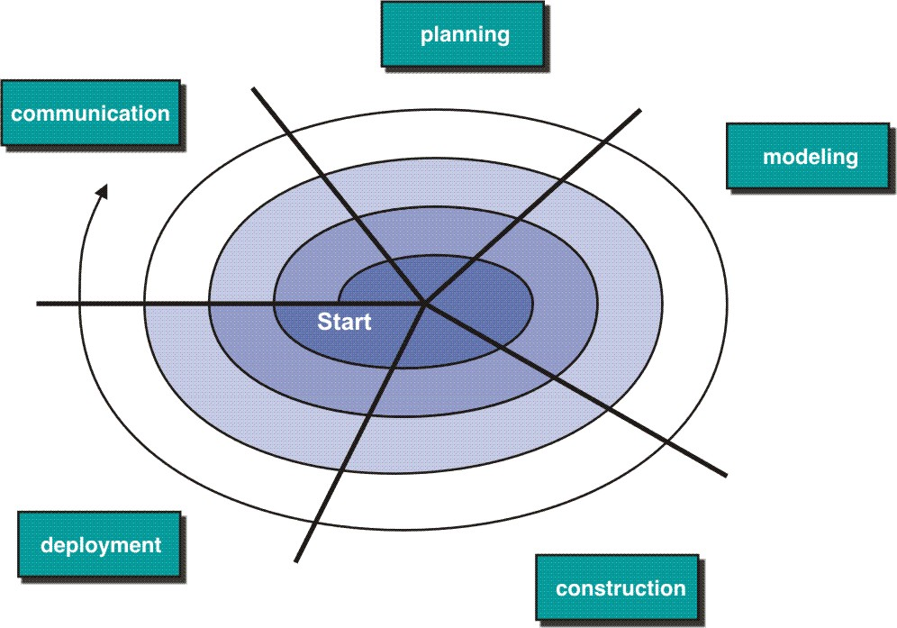
Evolutionary Model: Spiral Model

Slide 22
Spiral Model
Couples iterative nature of prototyping with the controlled and systematic aspects of the linear sequential model
It provide potential for rapid development of increasingly more complete version of the software.
Using spiral, software developed in as series of evolutionary release.
Early iteration, release might be on paper or prototype.
Later iteration, more complete version of software.
Divided into framework activities (C,P,M,C,D). Each activity represent one segment.
Evolutionary process begins in a clockwise direction, beginning at the center risk.
First circuit around the spiral might result in development of a product specification. Subsequently, develop a prototype and then progressively more sophisticated version of software.
Unlike other process models that end when software is delivered.
It can be adapted to apply throughout the life of software.

Slide 23
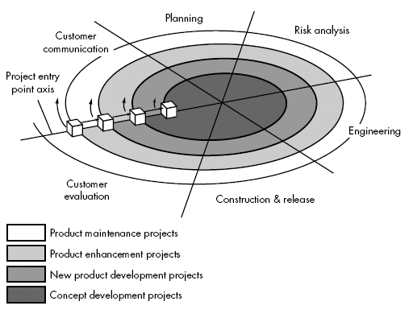
Spiral Model

Slide 24
Spiral Model (cont.)
Concept Development Project:
Start at the core and continues for multiple iterations until it is complete.
If concept is developed into an actual product, the process proceeds outward on the spiral.
New Product Development Project:
New product will evolve through a number of iterations around the spiral.
Later, a circuit around spiral might be used to represent a “Product Enhancement Project”
Product Enhancement Project:
There are times when process is dormant or software team not developing new things but change is initiated, process start at appropriate entry point.

Slide 25
Spiral models uses prototyping as a risk reduction mechanism but, more important, enables the developer to apply the prototyping approach at each stage in the evolution of the product.
It maintains the systematic stepwise approach suggested by the classic life cycle but also incorporates it into an iterative framework activity.
If risks cannot be resolved, project is immediately terminated
Problem Area:
It may be difficult to convince customers (particularly in contract situations) that the evolutionary approach is controllable.
If a major risk is not uncovered and managed, problems will undoubtedly occur.

Slide 26
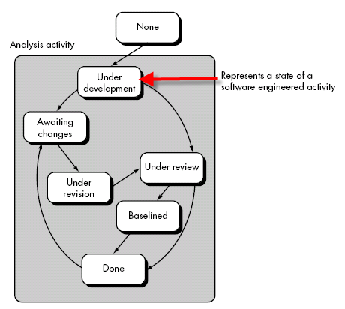
Concurrent Development Model

Slide 27
Concurrent Development Model
It represented schematically as series of major technical activities, tasks, and their associated states.
It is often more appropriate for system engineering projects where different engineering teams are involved.
The activity-modeling may be in any one of the states for a given time.
All activities exist concurrently but reside in different states.
E.g.
The analysis activity (existed in the none state while initial customer communication was completed) now makes a transition into the under development state.
Analysis activity moves from the under development state into the awaiting changes state only if customer indicates changes in requirements.
Series of event will trigger transition from state to state.
E.g. During initial stage there was inconsistency in design which was uncovered. This will triggers the analysis action from the Done state into Awaiting Changes state.

Slide 28
Concurrent Development (Cont.)
Visibility of current state of project
It define network of activities
Each activities, actions and tasks on the network exists simultaneously with other activities ,actions and tasks.
Events generated at one point in the process network trigger transitions among the states.

Slide 29
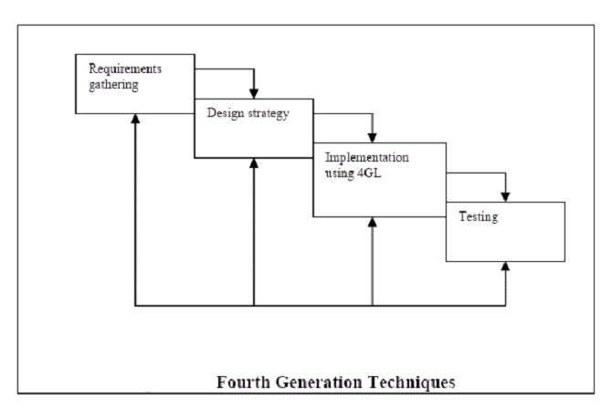
Fourth Generation Techniques(4GT)

Slide 30
Component Based Development
component-based development (CBD) model incorporates many of the characteristics of the spiral model.
It is evolutionary by nature and iterative approach to create software.
CBD model creates applications from prepackaged software components (called classes).

Slide 31
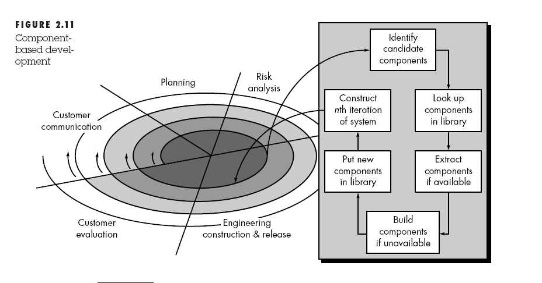
CBD Model

Slide 32
CBD model (cont.)
Modeling and construction activities begin with identification of candidate components.
Classes created in past software engineering projects are stored in a class library or repository.
Once candidate classes are identified, the class library is searched to determine if these classes already exist.
If class is already available in library extract and reuse it.
If class is not available in library, it is engineered or developed using object-oriented methods.
Any new classes built to meet the unique needs of the application.
Now process flow return to the spiral activity.

Slide 33
CBD Model (cont.)
CBD model leads to software reusability.
Based on studies, CBD model leads to 70 % reduction in development cycle time.
84% reduction in project cost.
Productivity is very high.

Slide 34
UNIT-III (Part-2)
Software Requirements

Slide 35
Objectives
To introduce the concepts of user and system requirements
To describe functional and non-functional requirements
To explain two techniques for describing system requirements
To explain how software requirements may be organised in a requirements document

Slide 36
Topics covered
Functional and non-functional requirements
User requirements
System requirements
The software requirements document

Slide 37
Requirements Engineering
The process of establishing the services that the customer requires from a system and the constraints under which it operates and is developed
The requirements themselves are the descriptions of the system services and constraints that are generated during the requirements engineering process

Slide 38
What is a requirement?
It may range from a high-level abstract statement of a service or of a system constraint to a detailed mathematical functional specification
This is inevitable as requirements may serve a dual function
May be the basis for a bid for a contract - therefore must be open to interpretation
May be the basis for the contract itself - therefore must be defined in detail
Both these statements may be called requirements

Slide 39
Types of requirement
User requirements
Statements in natural language plus diagrams of the services the system provides and its operational constraints. Written for customers
System requirements
A structured document setting out detailed descriptions of the system services. Written as a contract between client and contractor
Software specification
A detailed software description which can serve as a basis for a design or implementation. Written for developers

Slide 40
Definitions and specifications

Slide 41
Requirements readers

Slide 42
Functional and Non-Functional Requirements
Functional requirements
Statements of services the system should provide, how the system should react to particular inputs and how the system should behave in particular situations.
Non-functional requirements
constraints on the services or functions offered by the system such as timing constraints, constraints on the development process, standards, etc.
Domain requirements
Requirements that come from the application domain of the system and that reflect characteristics of that domain

Slide 43
Functional Requirements
Describe functionality or system services
Depend on the type of software, expected users and the type of system where the software is used
Functional user requirements may be high-level statements of what the system should do but functional system requirements should describe the system services in detail

Slide 44
Examples of Functional Requirements
The user shall be able to search either all of the initial set of databases or select a subset from it.
The system shall provide appropriate viewers for the user to read documents in the document store.
Every order shall be allocated a unique identifier (ORDER_ID) which the user shall be able to copy to the account’s permanent storage area.

Slide 45
Requirements imprecision
Problems arise when requirements are not precisely stated
Ambiguous requirements may be interpreted in different ways by developers and users
Consider the term ‘appropriate viewers’
User intention - special purpose viewer for each different document type
Developer interpretation - Provide a text viewer that shows the contents of the document

Slide 46
Requirements completeness and consistency
In principle requirements should be both complete and consistent
Complete
They should include descriptions of all facilities required
Consistent
There should be no conflicts or contradictions in the descriptions of the system facilities
In practice, it is impossible to produce a complete and consistent requirements document

Slide 47
Non-functional Requirements
Define system properties and constraints e.g. reliability, response time and storage requirements. Constraints are I/O device capability, system representations, etc.
Process requirements may also be specified mandating a particular CASE system, programming language or development method
Non-functional requirements may be more critical than functional requirements. If these are not met, the system is useless

Slide 48
Non-functional classifications
Product requirements
Requirements which specify that the delivered product must behave in a particular way e.g. execution speed, reliability, etc.
Organisational requirements
Requirements which are a consequence of organisational policies and procedures e.g. process standards used, implementation requirements, etc.
External requirements
Requirements which arise from factors which are external to the system and its development process e.g. interoperability requirements, legislative requirements, etc.

Slide 49
Non-functional requirement types

Slide 50
Goals and requirements
Non-functional requirements may be very difficult to state precisely and imprecise requirements may be difficult to verify.
Goal
A general intention of the user such as ease of use
Verifiable non-functional requirement
A statement using some measure that can be objectively tested
Goals are helpful to developers as they convey the intentions of the system users

Slide 51
Examples
A system goal
The system should be easy to use by experienced controllers and should be organised in such a way that user errors are minimised.
A verifiable non-functional requirement
Experienced controllers shall be able to use all the system functions after a total of two hours training. After this training, the average number of errors made by experienced users shall not exceed two per day.

Slide 52
Requirements measures

Slide 53
Requirements interaction
Conflicts between different non-functional requirements are common in complex systems
Spacecraft system
To minimise weight, the number of separate chips in the system should be minimised
To minimise power consumption, lower power chips should be used
However, using low power chips may mean that more chips have to be used. Which is the most critical requirement?

Slide 54
Domain requirements
Derived from the application domain and describe system characterisics and features that reflect the domain
May be new functional requirements, constraints on existing requirements or define specific computations
If domain requirements are not satisfied, the system may be unworkable

Slide 55
Library system domain requirements
There shall be a standard user interface to all databases which shall be based on the Z39.50 standard.
Because of copyright restrictions, some documents must be deleted immediately on arrival. Depending on the user’s requirements, these documents will either be printed locally on the system server for manually forwarding to the user or routed to a network printer.

Slide 56
Train protection system
The deceleration of the train shall be computed as:
D_{train} = D_{control} + D_{gradient}
where D_{gradient} is 9.81ms² * compensated gradient/alpha and where the values of 9.81ms² /alpha are known for different types of train.

Slide 57
Domain requirements problems
Understandability
Requirements are expressed in the language of the application domain
This is often not understood by software engineers developing the system
Implicitness
Domain specialists understand the area so well that they do not think of making the domain requirements explicit

Slide 58
User requirements
Should describe functional and non-functional requirements so that they are understandable by system users who don’t have detailed technical knowledge
User requirements are defined using natural language, tables and diagrams

Slide 59
Problems with natural language
Lack of clarity
Precision is difficult without making the document difficult to read
Requirements confusion
Functional and non-functional requirements tend to be mixed-up
Requirements amalgamation
Several different requirements may be expressed together

Slide 60
Database requirement
4.A.5 The database shall support the generation and control of configuration objects; that is, objects which are themselves groupings of other objects in the database.
The configuration control facilities shall allow access to the objects in a version group by the use of an incomplete name.

Slide 61
Guidelines for writing requirements
Invent a standard format and use it for all requirements
Use language in a consistent way. Use shall for mandatory requirements, should for desirable requirements
Use text highlighting to identify key parts of the requirement
Avoid the use of computer jargon

Slide 62
System requirements
More detailed specifications of user requirements
Serve as a basis for designing the system
May be used as part of the system contract
System requirements may be expressed using system models.

Slide 63
Requirements and design
In principle, requirements should state what the system should do and the design should describe how it does this
In practice, requirements and design are inseparable
A system architecture may be designed to structure the requirements
The system may inter-operate with other systems that generate design requirements
The use of a specific design may be a domain requirement

Slide 64
Problems with NL specification
Ambiguity
The readers and writers of the requirement must interpret the same words in the same way. NL is naturally ambiguous so this is very difficult
Over-flexibility
The same thing may be said in a number of different ways in the specification
Lack of modularisation
NL structures are inadequate to structure system requirements

Slide 65
Alternatives to NL specification

Slide 66
Structured language specifications
A limited form of natural language may be used to express requirements
This removes some of the problems resulting from ambiguity and flexibility and imposes a degree of uniformity on a specification
Often best supported using a forms-based approach

Slide 67
Form-based specifications
Definition of the function or entity
Description of inputs and where they come from
Description of outputs and where they go to
Indication of other entities required
Pre and post conditions (if appropriate)
The side effects (if any)

Slide 68
Form-based node specification

Slide 69
PDL-based requirements definition
Requirements may be defined operationally using a language like a programming language but with more flexibility of expression
Most appropriate in two situations
Where an operation is specified as a sequence of actions and the order is important
When hardware and software interfaces have to be specified
Disadvantages are
The PDL may not be sufficiently expressive to define domain concepts
The specification will be taken as a design rather than a specification

Slide 70
Part of an ATM specification

Slide 71
PDL disadvantages
PDL may not be sufficiently expressive to express the system functionality in an understandable way
Notation is only understandable to people with programming language knowledge
The requirement may be taken as a design specification rather than a model to help understand the system

Slide 72
Interface specification
Most systems must operate with other systems and the operating interfaces must be specified as part of the requirements
Three types of interface may have to be defined
Procedural interfaces
Data structures that are exchanged
Data representations
Formal notations are an effective technique for interface specification

Slide 73
PDL interface description

Slide 74
The requirements document
The requirements document is the official statement of what is required of the system developers
Should include both a definition and a specification of requirements
It is NOT a design document. As far as possible, it should set of WHAT the system should do rather than HOW it should do it

Slide 75
Users of a requirements document

Slide 76
Requirements document requirements
Specify external system behaviour
Specify implementation constraints
Easy to change
Serve as reference tool for maintenance
Record forethought about the life cycle of the system i.e. predict changes
Characterise responses to unexpected events

Slide 77
IEEE requirements standard
Introduction
General description
Specific requirements
Appendices
Index
This is a generic structure that must be instantiated for specific systems

Slide 78
Requirements document structure
Introduction
Glossary
User requirements definition
System architecture
System requirements specification
System models
System evolution
Appendices
Index

Slide 79
Key points
Requirements set out what the system should do and define constraints on its operation and implementation
Functional requirements set out services the system should provide
Non-functional requirements constrain the system being developed or the development process
User requirements are high-level statements of what the system should do

Slide 80
Key points
User requirements should be written in natural language, tables and diagrams
System requirements are intended to communicate the functions that the system should provide
System requirements may be written in structured natural language, a PDL or in a formal language
A software requirements document is an agreed statement of the system requirements

